Slide 1

Dr Alka Sehgal Cuthbert
Director of Don’t Divide Us
team@dontdivideus.com
https://dontdivideus.com

Slide 2
Notes For Teachers (i)
The slides are from a lesson Dr Alka Sehgal Cuthbert gave as a guest lecture at a sixth-form college to a class of upper sixth students hoping to apply to Russell Group universities. The aim was to provide a challenging, structured introduction that would encourage deeper and wider thinking and engagement with moral ideas about freedom, racism and anti-racism, through introducing a less well-known figure from history.
The book used is Macmillan Collectors Library edition of ‘Narrative of the Life of Frederick Douglass’, 2022 with an introduction by Lydia Plath. It is not intended to be a history lesson, although you can bring in as much or as little historical context as you see fit. Nor is it a comprehensive summary of the book – hopefully some will be more inclined to get the book and read it for themselves.

Slide 3
(ii)
The slides select extracts salient around which to structure a collective conversation with your pupils. The point is to open a discussion on core questions: how does a slave become a man? How was knowledge, and reading in particular so important in his struggle for freedom? How were other people, good and bad, influential in his life? It goes without saying that the more familiar you are with the book the more likely you will have an interesting and meaningful conversation with your pupils. Some broader questions for discussion are in the notes box of the last slide. The aim is to tease out differences and prompt thinking rather than ‘winning an argument’.

Slide 4
(iii)
Most importantly, his life shows that there is a common humanity shared by all people across lines of race and colour. In this sense, the lesson is committed to a broader colourblind politics, where differences are important in so far as they help develop and improve a common good. Douglass’ story shows that when the causes of freedom and equality are believed in strongly enough by many people, across lines of colour, nationality and class, people can indeed contribute to making the world better for more people.

Slide 5
Some Responses from Students...
‘The session was informative and open, I took a lot from the talk and it encouraged me to be more critical of mainstream opinions. It was interesting to learn about Frederick Douglass as he is a figure not widely discussed when teaching younger people about slavery.’
‘It was a very good talk and really made me reconsider my views upon critical race theory, and the current problems with the education system. It really opened my eyes to the lesser known people who fought for the civil rights movement.'
'I think the session opens people up to ideas and theories that are not often spoken about , but appear very important in understanding race and equality on a wider scale. Furthermore, I think learning about individuals like Douglass is valuable as it further widen the view on equality.'

Slide 6
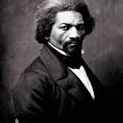
What Can We Learn from the Life of Frederick Douglass? (1817-1895)
Notes:
Context of two rival ideological approaches to racism, discrimination and how best respond. Douglass’ narrative illustrates above all that no-one, not even a slave, is deprived of their agency. This belief runs counter to a belief in individuals being fully determined by their social, political and economic circumstances. This doesn’t mean Douglass was a superman, able to fly in the face of all the terrible obstacles he faced as a black slave in America at that particular time. It does mean his individual determination and refusal to be defeated by circumstances outside his control, encouraged him to see possibilities that existed at the same time.

Slide 7

LESSON #1 – There’s more than one way to break a human being. . . Physical destruction or moral de-humanisation
Notes:
The determination to exert his agency against attempts to dehumanize him, is expressed when he writes: ‘You have seen how a man was made a slave; you shall see how a slave becomes a man.’ His belief in his power to change his own status – from man to slave and then the reverse – suggests an outlook on the world and people that was hospitable to humanist belief which gives a high value to individual free-will, even if little else about his life as a slave could be called free. This differs from an outlook which prioritises social, political and economic effects on individuals which limit, or negate, free-will.
Possible questions at this point, or at the end: What outlook do you think is dominant today? Can the two outlooks exist at the same time and in the same place?

Slide 8
From Douglass’s lecture on slavery, Rochester, USA, 1850
“The first work of slavery is to mar and deface those characteristics of its victims which distinguish men from things, and persons from property. Its first aim is to destroy all sense of high moral and religious responsibility. It reduces man to a mere machine. It cuts him off from his Maker, it hides from him the laws of God, and leaves him to grope his way from time to eternity in the dark, under the arbitrary and despotic control of a frail, depraved, and sinful fellow-man”
Notes:
Emphasis today to assume that the empirical – what is accessible through our perceptual apparatus – is more real, or more valuable – than less tangible goods. Douglass here highlight the importance of morality and metaphysical religious thought - neither of which are material things: both good conduct and thought are products of our intellect, judgment and our will. At heart, Douglass makes a passionate plea for the moral dignity of all individuals which, for him, lies in religious belief. Although he was very critical of the hypocrisy of the Christians he met or overheard who failed to extend their concern to slavery, in his Appendix he states his support of Christianity itself.

Slide 9
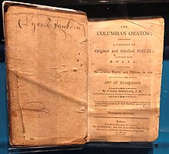
Lesson #2 – knowledge requires a conscious & directed will, it’s not a technical achievement
Notes:
‘The Columbian Orator’ was published in 1797 by Caleb Bingham, an educator and publisher. It contained political speeches, essays, imagined dialogues, poems – all of which were selected to improve the knowledge , patriotic sentiment and rhetoric of growing number of wealthy Americans. Here Douglass could read poems by Robert Burns, such as The Slave’s Lament, and Dialogue Between a Slave and Master which he found deeply inspiring. Later on his visit to Britain, he visited Scotland and spoke of his admiration for Robert Burns. It was a publication that articulated the aspiration of human perfectibility through using one’s own faculties, including rhetoric which was an important part of public speech and political persuasion.

Slide 10
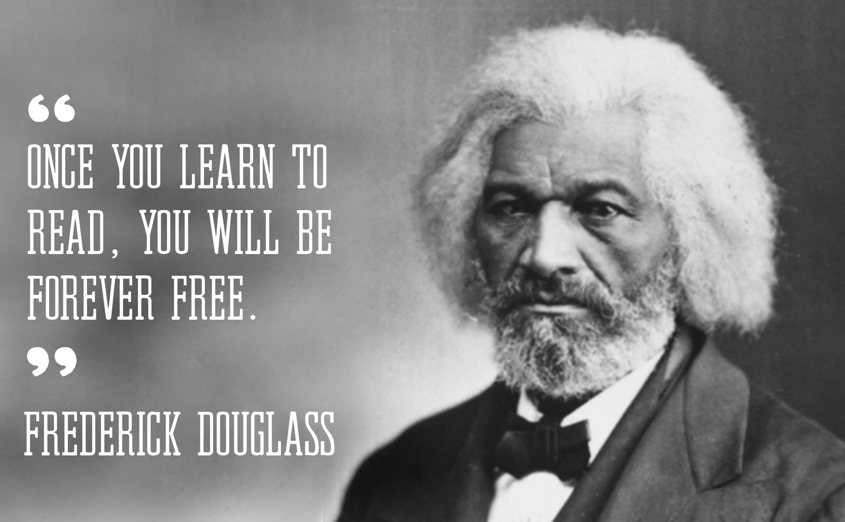
Notes:
He was still a slave when he learned to read – so what kind of freedom did he mean?

Slide 11
LESSON #3 – freedom inspires courage
‘My long-crushed spirit rose, cowardice departed, bold defiance took its place; and I now resolved that, however long I might remain a slave in form, the day had passed forever when I could be a slave in fact.’
‘You have seen how a man was made a slave; you shall see how a slave was made a man.’
(from Narrative of the Life of Frederick Douglass)
Notes:
Education = a form of mental and imaginative freedom and practical efforts in cause of freedom often go hand in hand – would he have had this resolve had he not been able to read the books and essays he did? Notably The Columbian Orator and later The Liberator edited by Wiiliam Loyd Garrison
And the Scottish poet Robert Burns – who wrote ‘A Slave’s Lament’ in 1792
When Douglass arrived in Baltimore at the age of 7 to work for his original master’s family, he was struck by differences between a large town and the Maryland farmstead where he was born. The people, the gatherings in the house, the conversations about religion, politics, local events, and even, perhaps in hushed tones, the abolitionists. He was hired out to a particularly brutal man a few years later and retaliated when being beaten. The effects of his reading, conversations overheard, a talisman given to him by an older slave, and sheer willpower, must have combined to help his spirit rise. He didn’t defeat his master, but from then on that master left him alone.

Slide 12
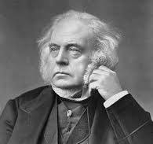
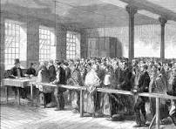
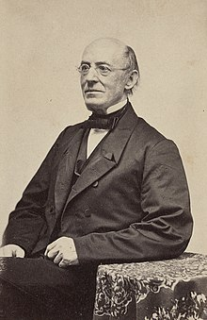
The struggle for freedom requires building solidarity, takes time – and can inspire through the ages and across continents.
But with a little help from friends....
John Bright
Millworkers
William Lloyd Garrison
Notes:
Offered financial support, shelter, advice, encouragement and moral support to ensure Douglass et al could participate in America’s emerging democracy as an equal citizen – did not offer pity, special favours, safe spaces that privileges that the rival ideology – Social Critical Justice - advocates in the name of equity today. Encouraged Douglass to become his own person, not a representative of a race. “I came here a slave, but I go back free’ - on returning after his 3 year stay in Britain ; speaking tours, Rochdale, Manchester (4,000+ audience). Quaker Ellen Richardson fundraised.
Possible Questions – in the light of Douglass’s narrative –1) what meaning and value SHOULD we give to the beliefs today that the experience of racism proves that black and white people are inherently victims or oppressors? 2) A new political idea today is that the injustices of slavery continue today but in different forms, such as microagressions (you may need to define this) - how far do you agree with this idea? 3) One criticism of the view presented in this lesson is that it suggests everyone has to be a superhero like Douglass and not everyone is as strong or determined, plus society is so different now, so we can’t really learn much from his life. How far do you agree or disagree with this view?

